Slide 1
Capstone Project: cashflow
Preet Sekhon
01.13.23

Slide 2

Agenda
Real Estate Discussion
Data Science Workflow
Findings
Recommendations

Slide 3

Problem Statement
A group of large investors are pooling their money together to add real estate to their portfolio. Are you able to design a strategy on how best to allocate capital?

Slide 4
Real Estate

Slide 5
The 3 Rules of Real Estate
Cash Flow
Cash Flow
Cash Flow

Slide 6
Why Invest for Cash Flow?
Your Cash Works for You
Growth
Fixed Costs but Rental Growth
Bonuses
Principle Pay Down
Appreciation

Slide 7
CASH FLOW
Revenue
Rent
Costs
PITI
Principal
Interest
Taxes(Property)
Insurance
Maintenance
Profit
Revenue – Costs = $Profit
This is your Cash Flow

Slide 8
Costs
Initial Cost
Referenced as the first “Cash” in Cash on Cash Return
25% Down Payment
Monthly Costs
Mortgage
Principle
79% of ‘MLS_Amount'
Remaining 75%
Closing Costs = 4% of ‘MLS_Amount’
30 Year Fixed Rate Mortgage
6.5% Interest Rate
Property Tax = .71% of ‘MLS_Amount’
Insurance = .25% of ‘MLS_Amount’
Maintenance = .3% of ‘MLS_Amount’

Slide 9
Cash oN Cash Return
Cash Flow
Divided by
Initial Costs

Slide 10
Cash on Cash Return
Q: What is a good cash-on-cash return?
A: It depends on the investor, the local market, and your expectations of future value appreciation. Some real estate investors are happy with a safe and predictable CoC return of 7% – 10%, while others will only consider a property with a cash-on-cash return of at least 15%.
Stessa, A Roofstock Company

Slide 11
Rental API
Min Rent, Avg Rent, Max Rent
Average Rent
Average Rent – Costs =
Average Cash on Cash Return
Target Feature

Slide 12
Data Science Workflow

Slide 13
Data Science Workflow
Collection
Cleaning and Preprocessing
EDA
Modeling
Conclusions

Slide 14
Source | Rows | Columns
Voter Info | 41 | 28
Census Info | 41 | 147
Real Estate Listings | 22,639 | 23
Rental Listings | 1323 | 25
CA.Gov – Voter Data
Census Info 2021
Population
Income
Real Estate Listings
Propstream.com
Rental Listings
API
2020-2022

Slide 15




The Data
A large portion of this project was spent on Data Collection and creating one Data Set
Final Data Set (14546 , 261)*
All Nulls Removed

Slide 16
Exploratory Data Analysis

Slide 17
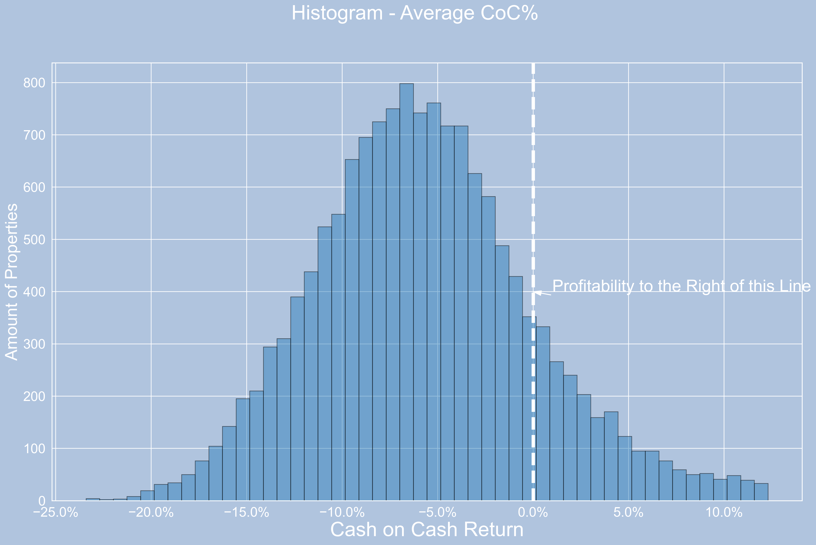
Distribution
14.8% of Listings are Profitable

Slide 18
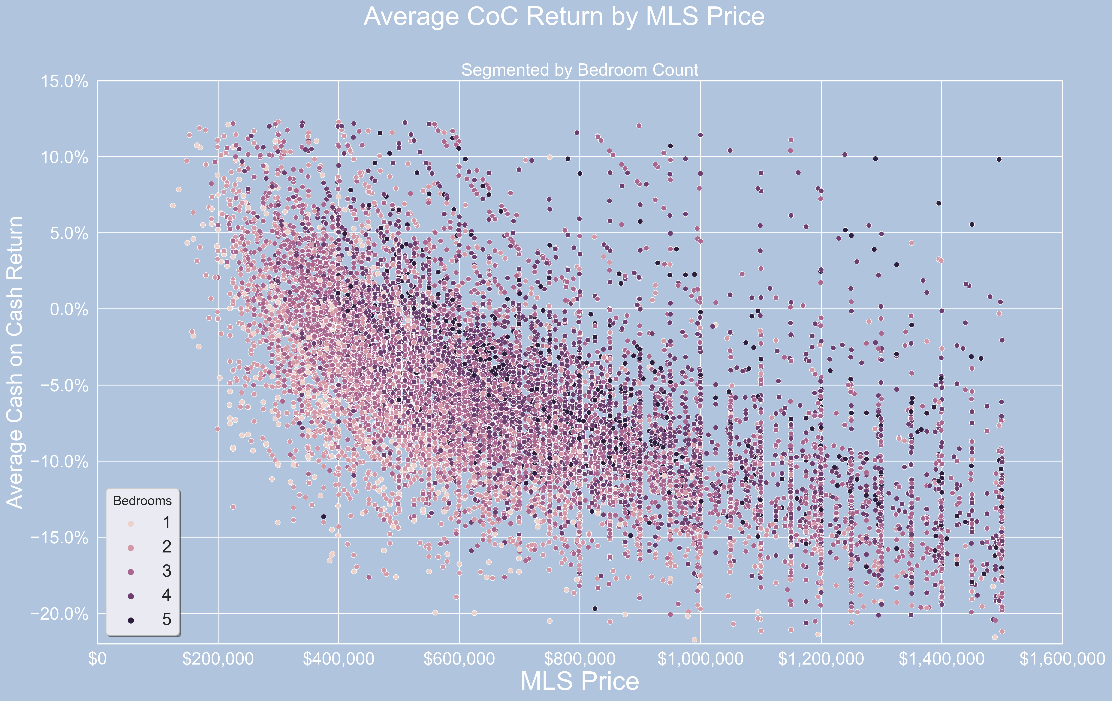
Less Bedrooms
Less Expensive Homes

Slide 19
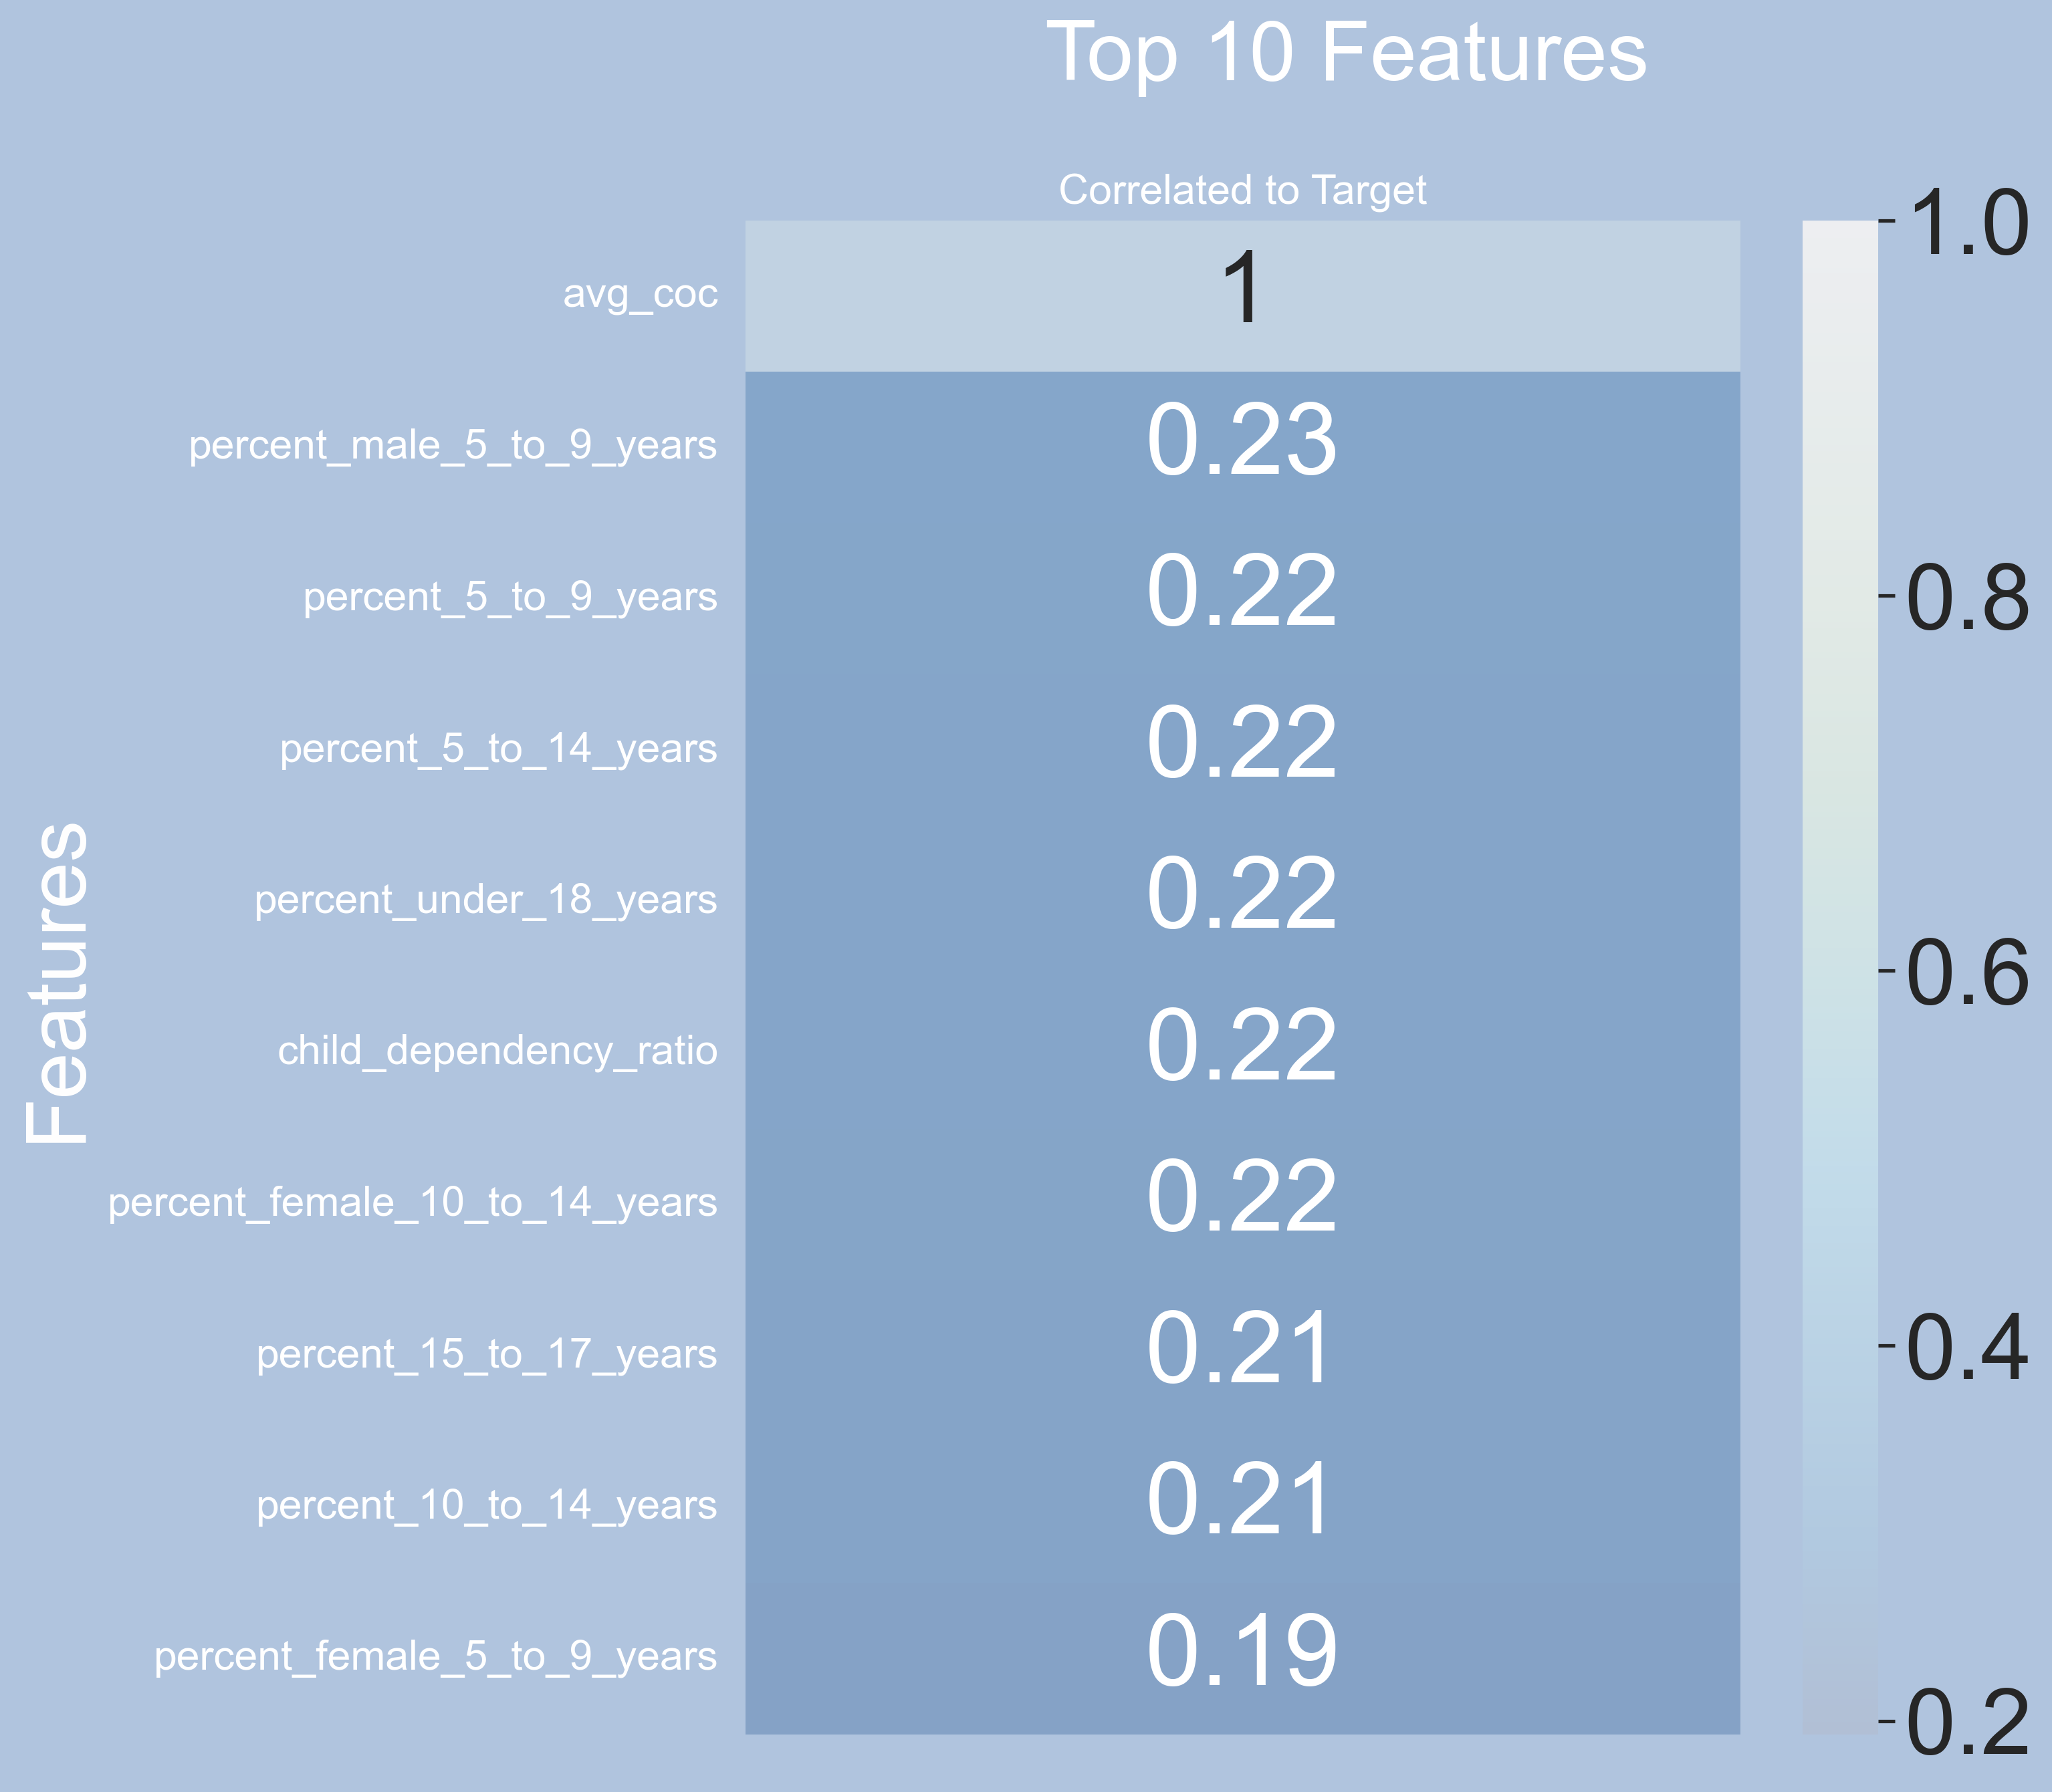
Heat Map
Highest Correlation to our Target Feature is associated with Renters who are Families

Slide 20
Modeling

Slide 21
Linear Regression Models
With GridSearch CV
Regression Models | Train Score | Test Score | RMSE
Linear | .342 | .343 | .046
Random Forest | .918 | .434 | .043
Decision Tree | .999 | -.098 | .059
Support Vector Machines | -320 | -316 | .548

Slide 22
Pivot: Linear Regression to Classification
After much consideration and Regression Modeling the decision was made to shift to Classification Models. Our new target variable, Target Cash Flow Positivity(TCFP) was created.
Average Cash on Cash Return above or equal to 4% makes TCFP = 1(True), lower than 4% = 0(False).
Distribution of TCFP:
1 - 5.6%
0 - 94.4%

Slide 23
Unbalanced Data
1 - 5.6%
0 - 94.4%
Since our distribution of our target variable was so un-balanced we employed SMOTEENN in our Models.
SMOTEENN is a technique that resamples the data and creates synthetic samples using KNN.

Slide 24
Classification Models
Classification Models | Brier Score Train Set | Brier Score Test Set | Precision Train Set | Precision Test Set
Logistic Regression | .207 | .202 | .695 | .710
Random Forest | .146 | .145 | .791 | .792
XGBoost | .044 | .047 | .962 | .949
Brier Score is better if lower
All models used SMOTEENN and BayesSearchCV

Slide 25
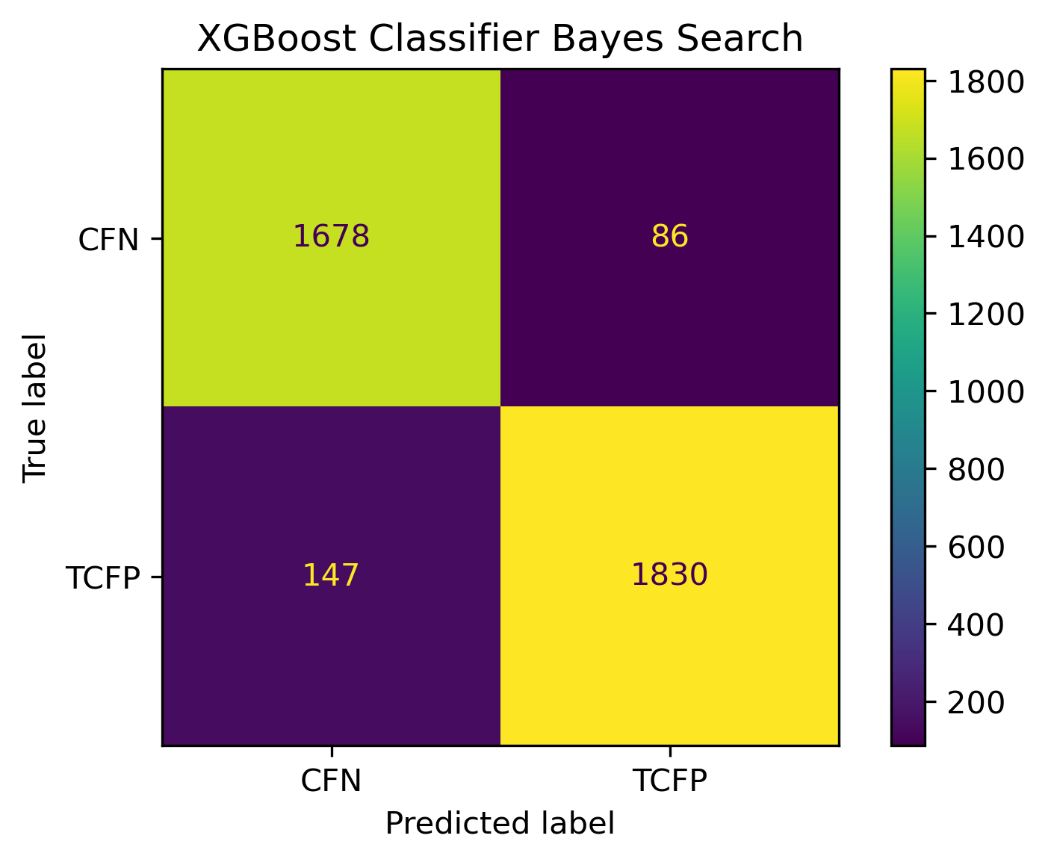
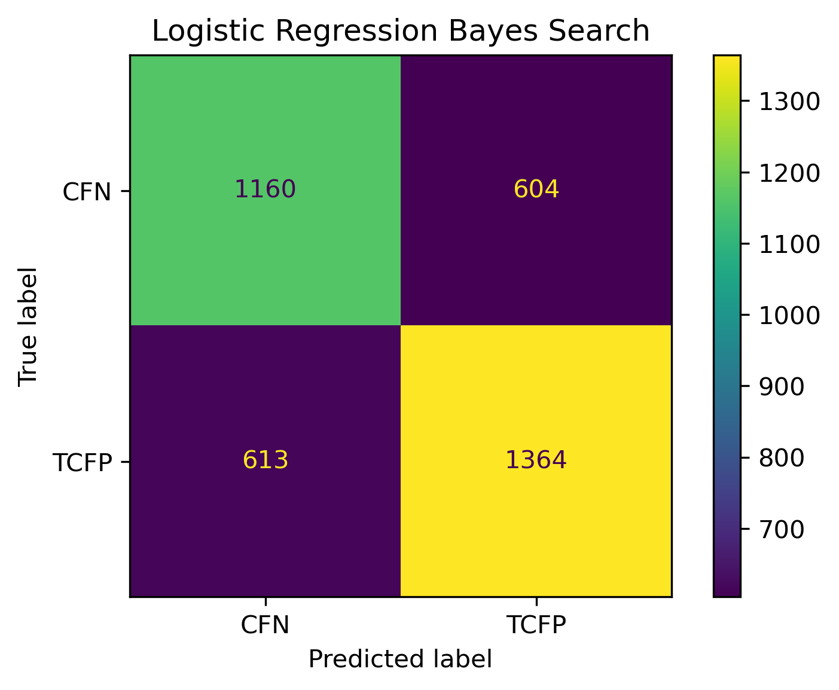
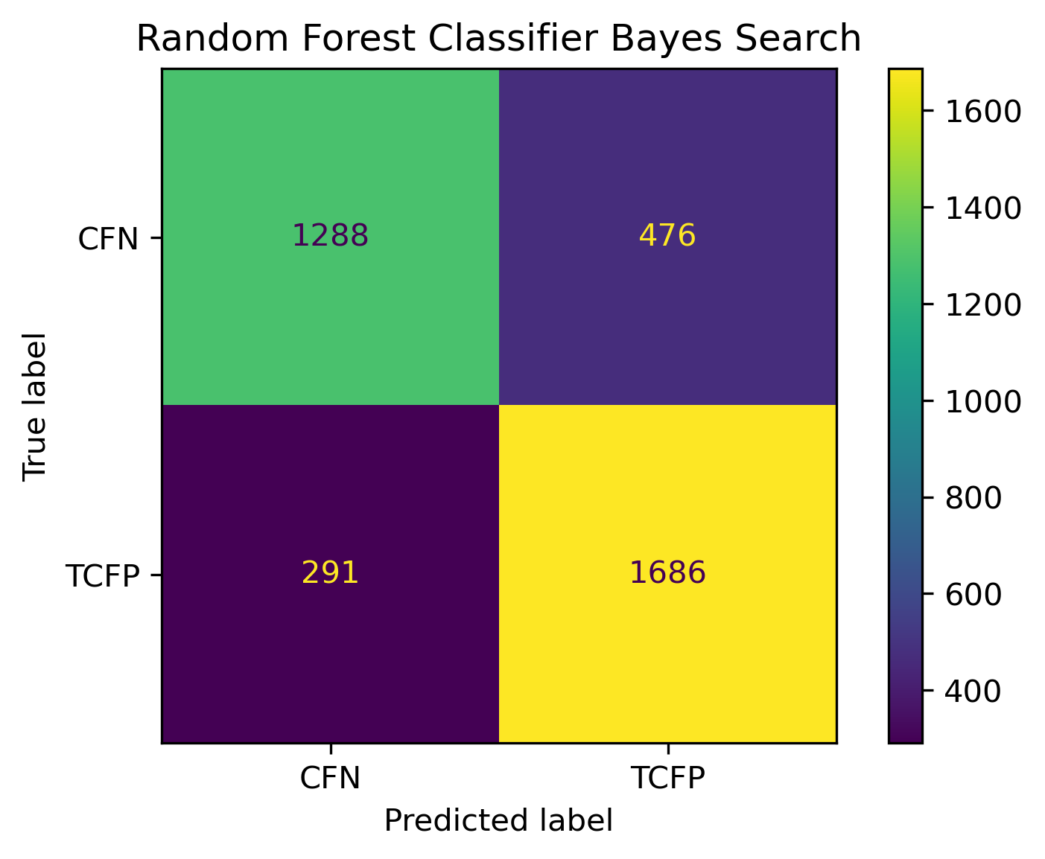
Classification Models: Confusion Matrix
Precision Score: 94.9%
Precision Score: 71.0%
Precision Score: 792%

Slide 26
XGBoost Feature Importance
Feature | Importance
Median Household Income - White | .094
3 Bathrooms | .072
Single Family Residence | .054
Median Household Income | .049
2020 Turnout Eligible | .045
Child Dependency Ratio | .042
*Coincide with our Heat Maps from EDA

Slide 27
Recommendations

Slide 28
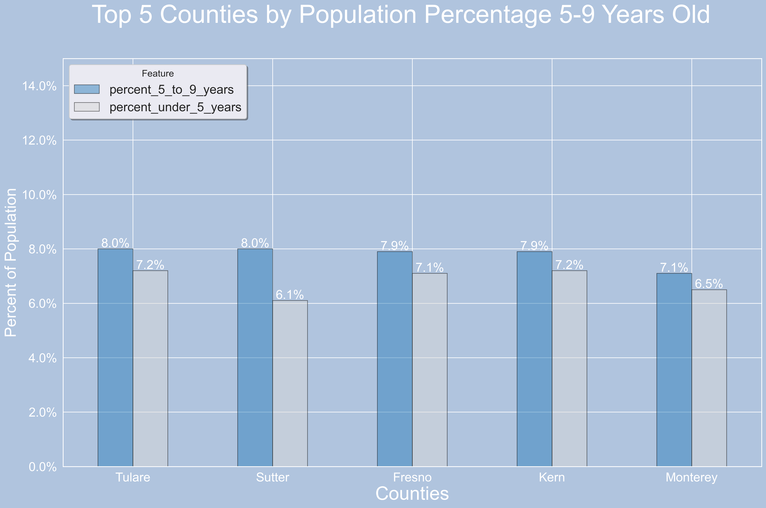

Task 1A: Top 5 city/counties for our top correlated feature
Population % 5-9 Years
6.2% Average per County

Slide 29
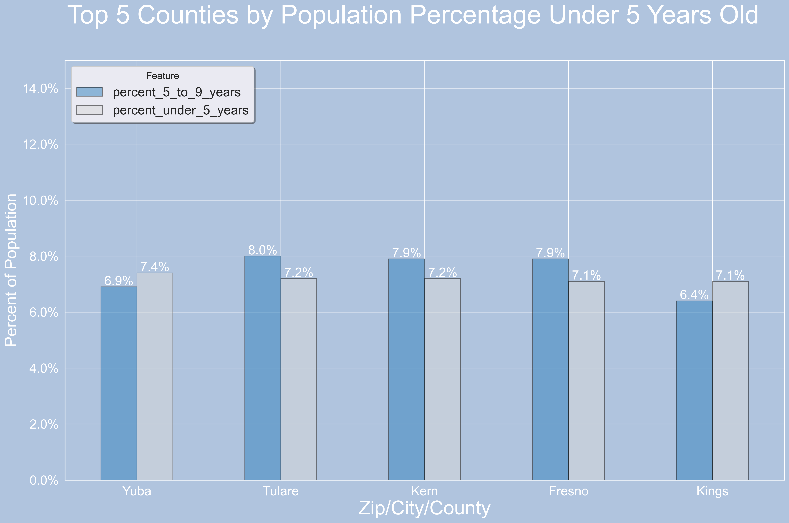
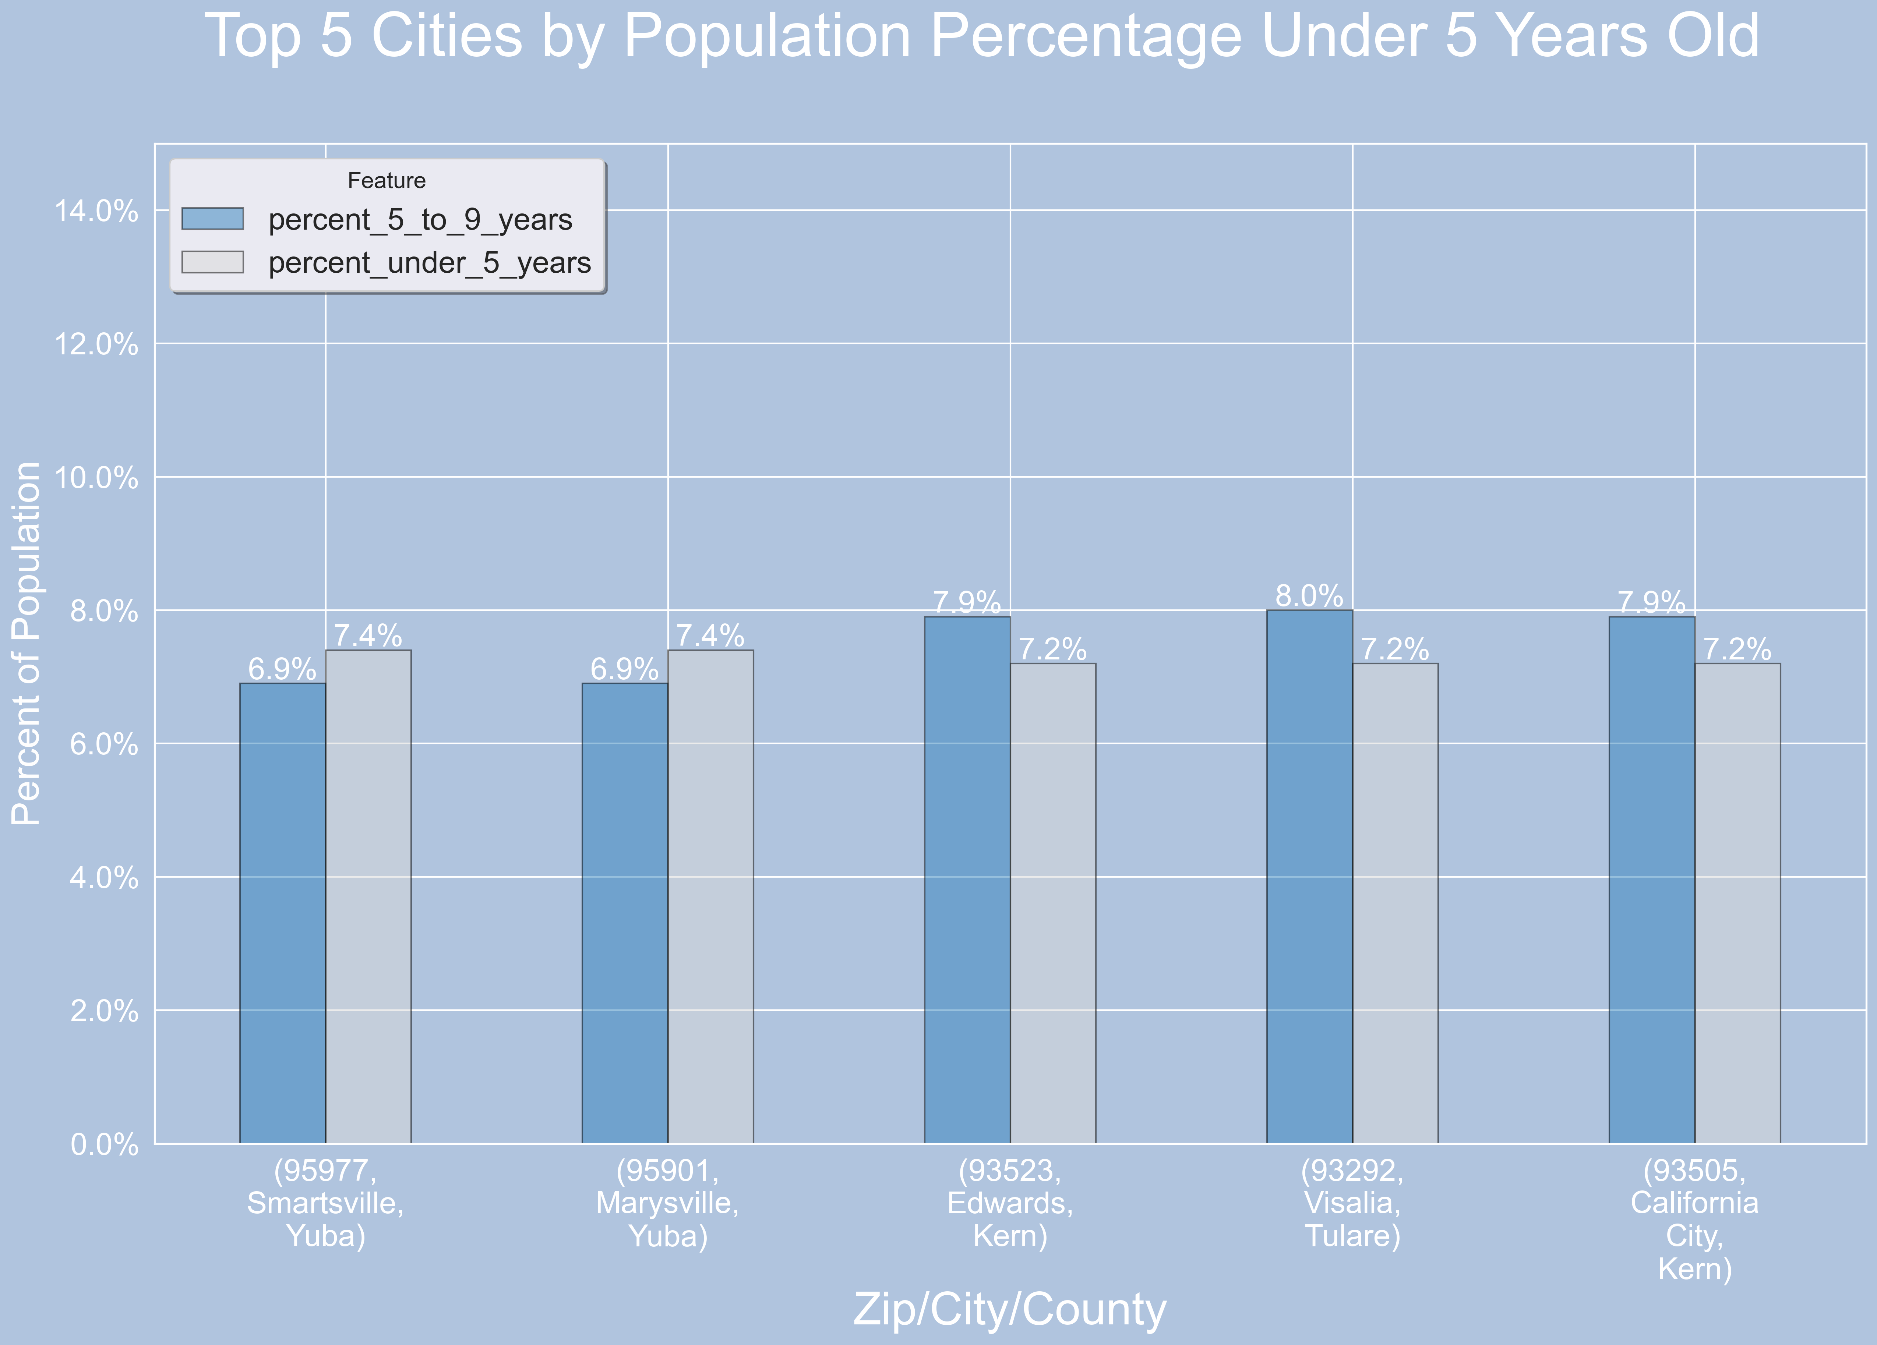
Task 1b: top 5 cities/counties for future correlation feature rich market
Population % under 5 Years
5.7% Average per County

Slide 30
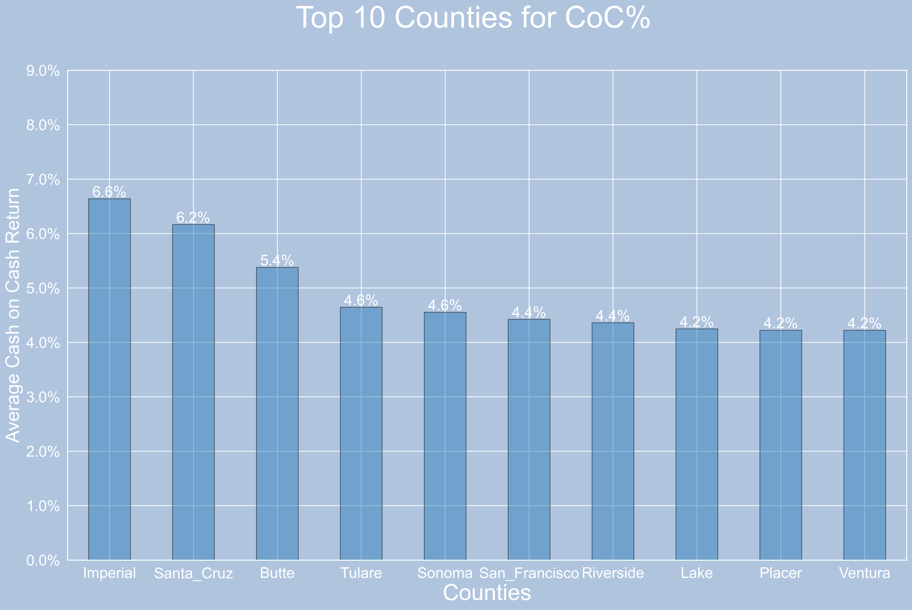
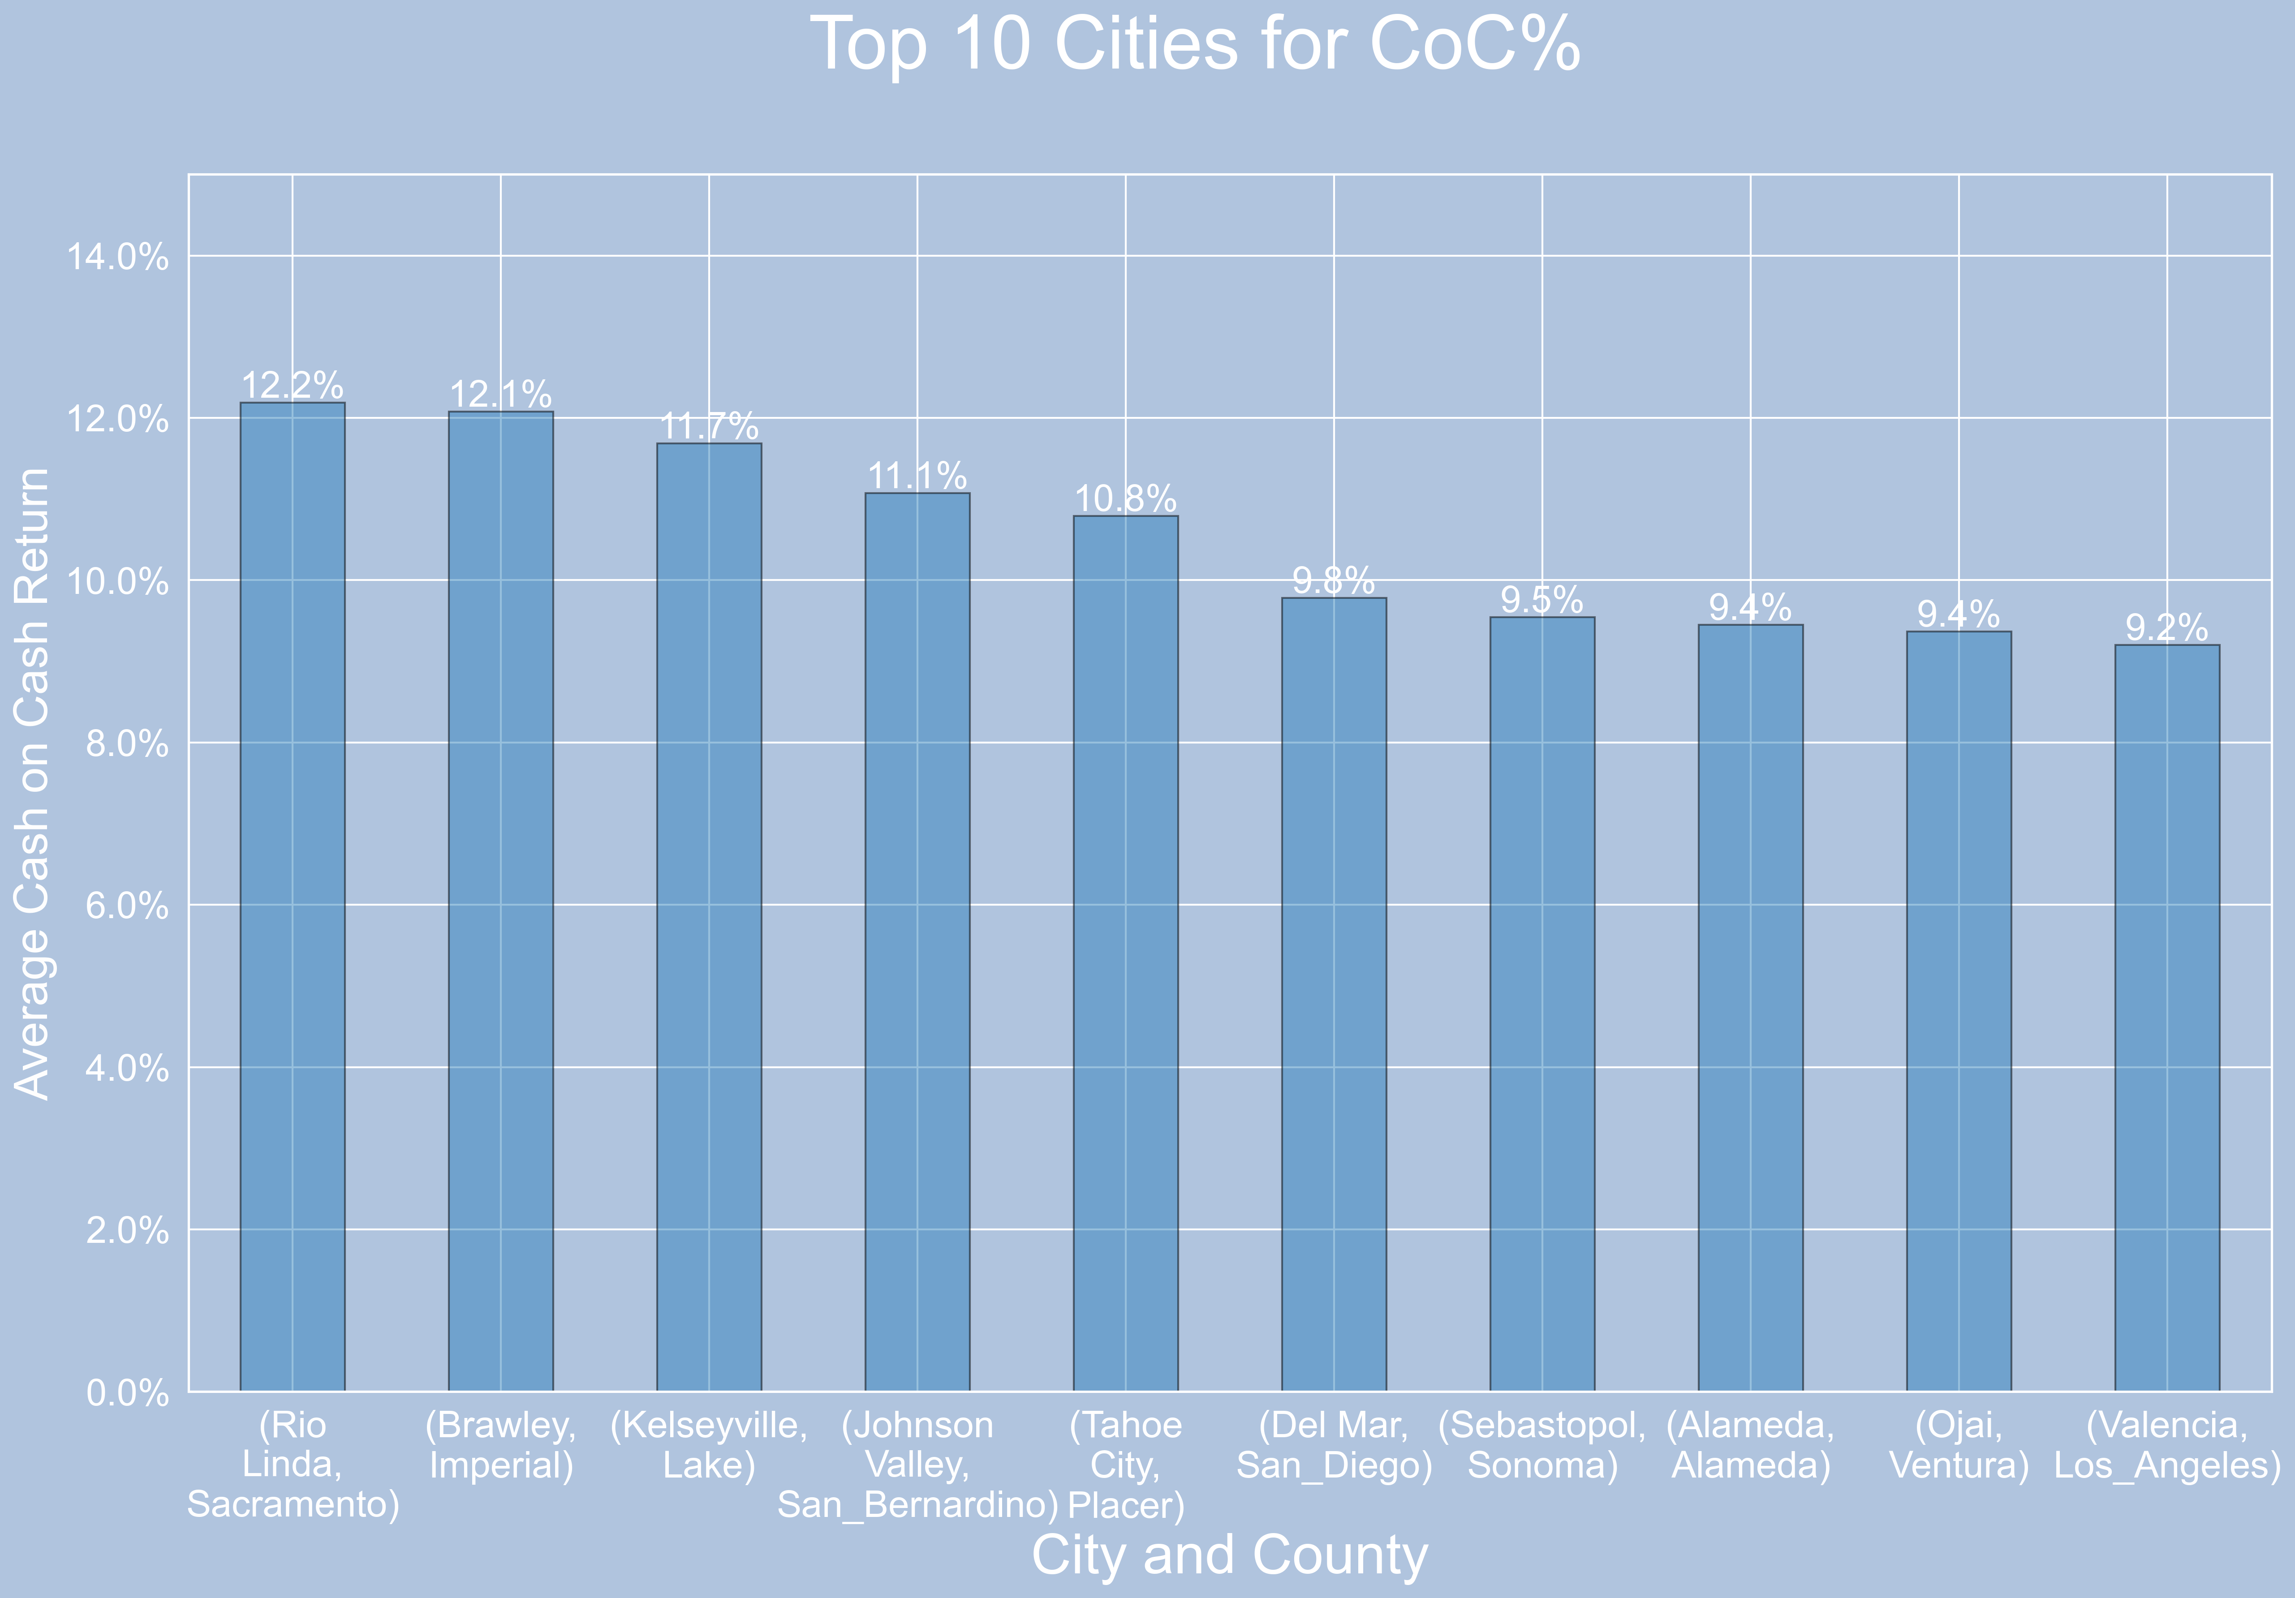
Task 2: Top 10 cities or counties for coc%
A more Focused Strategy will drive a Higher CoC Return. On average, over double.

Slide 31
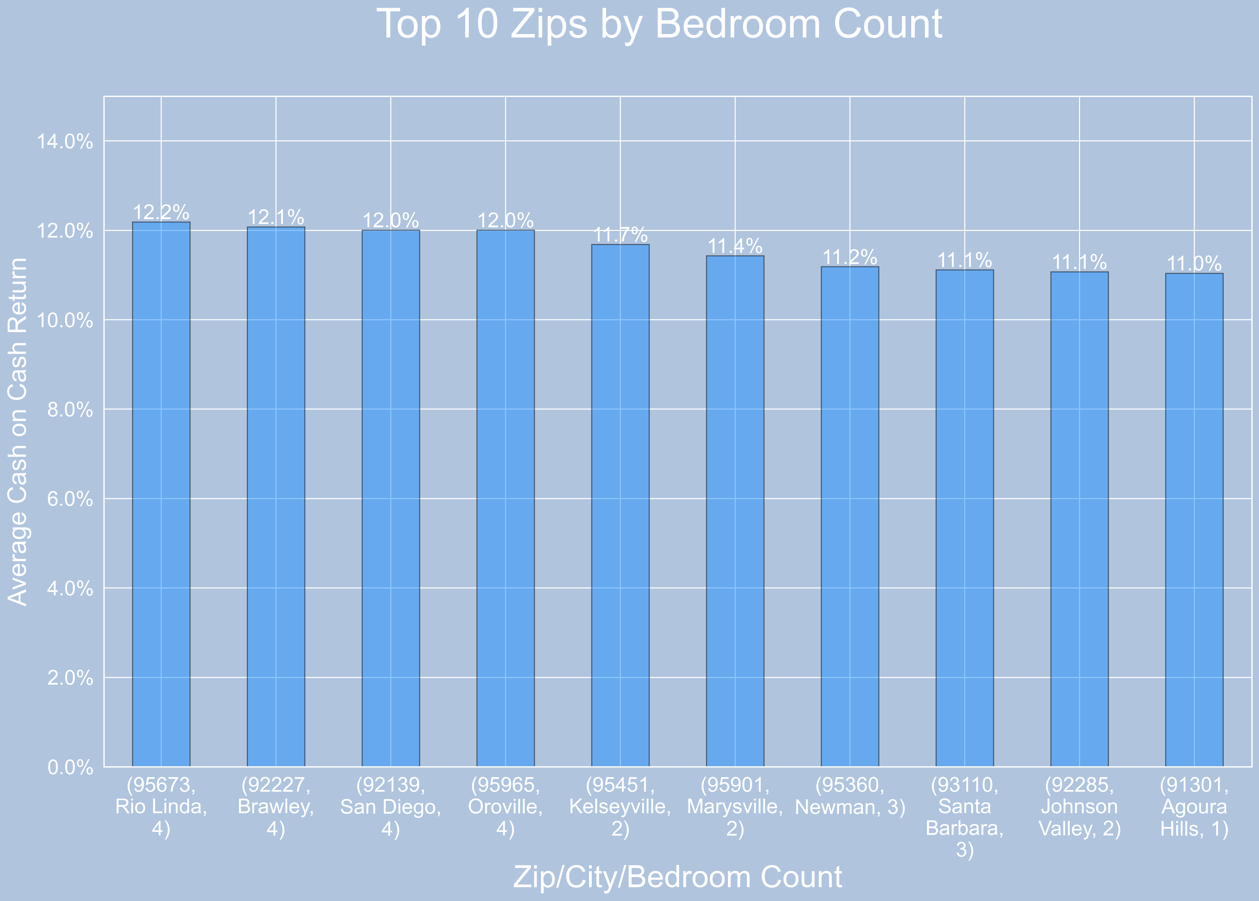
Task 3: By Zip and Bedroom count
For our 3rd part of our Investment Strategy we will be hyper focused and target specific Zip Codes and Bedroom Counts

Slide 32

Overall Strategy
After further review of Tasks 1-3, look for opportunities to cluster investments. Clustering will provide a reduction of overhead and allow for a certain amount of scalability.

Slide 33




Thank you
Questions and Comments?

Slide 34
Appendix

Slide 35
Invest for the Now
Percent 5 to 9 years | County | Median Rent | Rank
8.4 | Merced | $1,824 | 34
8 | Sutter | $1,920 | 28
8 | Tulare | $1,728. | 36
7.9 | Fresno | $1,834 | 33
7.1 | Monterey County | $2,402 | 20

Slide 36
Invest for the Future
Median Rent | Rank | Percent Under 5 years | County
$1,893 | 31 | 7.4 | Yuba
$1,660 | 37 | 7.2 | Kern
$1,729 | 36 | 7.2 | Merced
$1,825 | 34 | 7.2 | Tulare
$1,835 | 33 | 7.1 | Fresno
$1,896 | 30 | 6.8 | Stanislaus

Slide 37
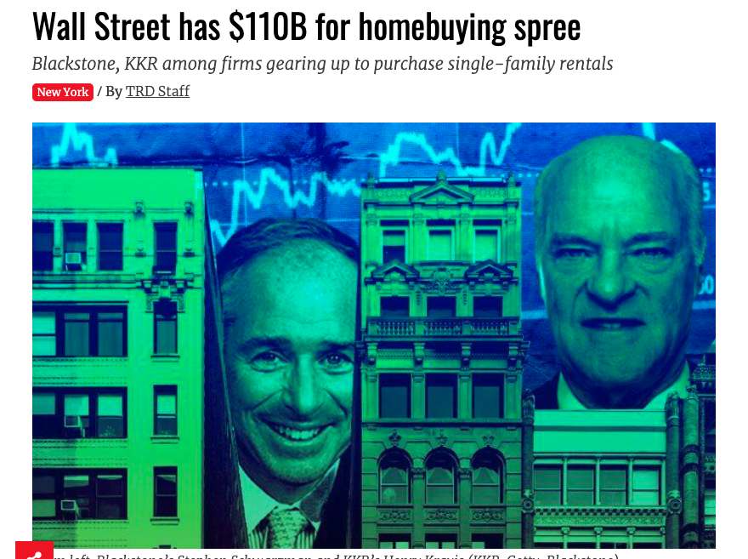

Slide 38
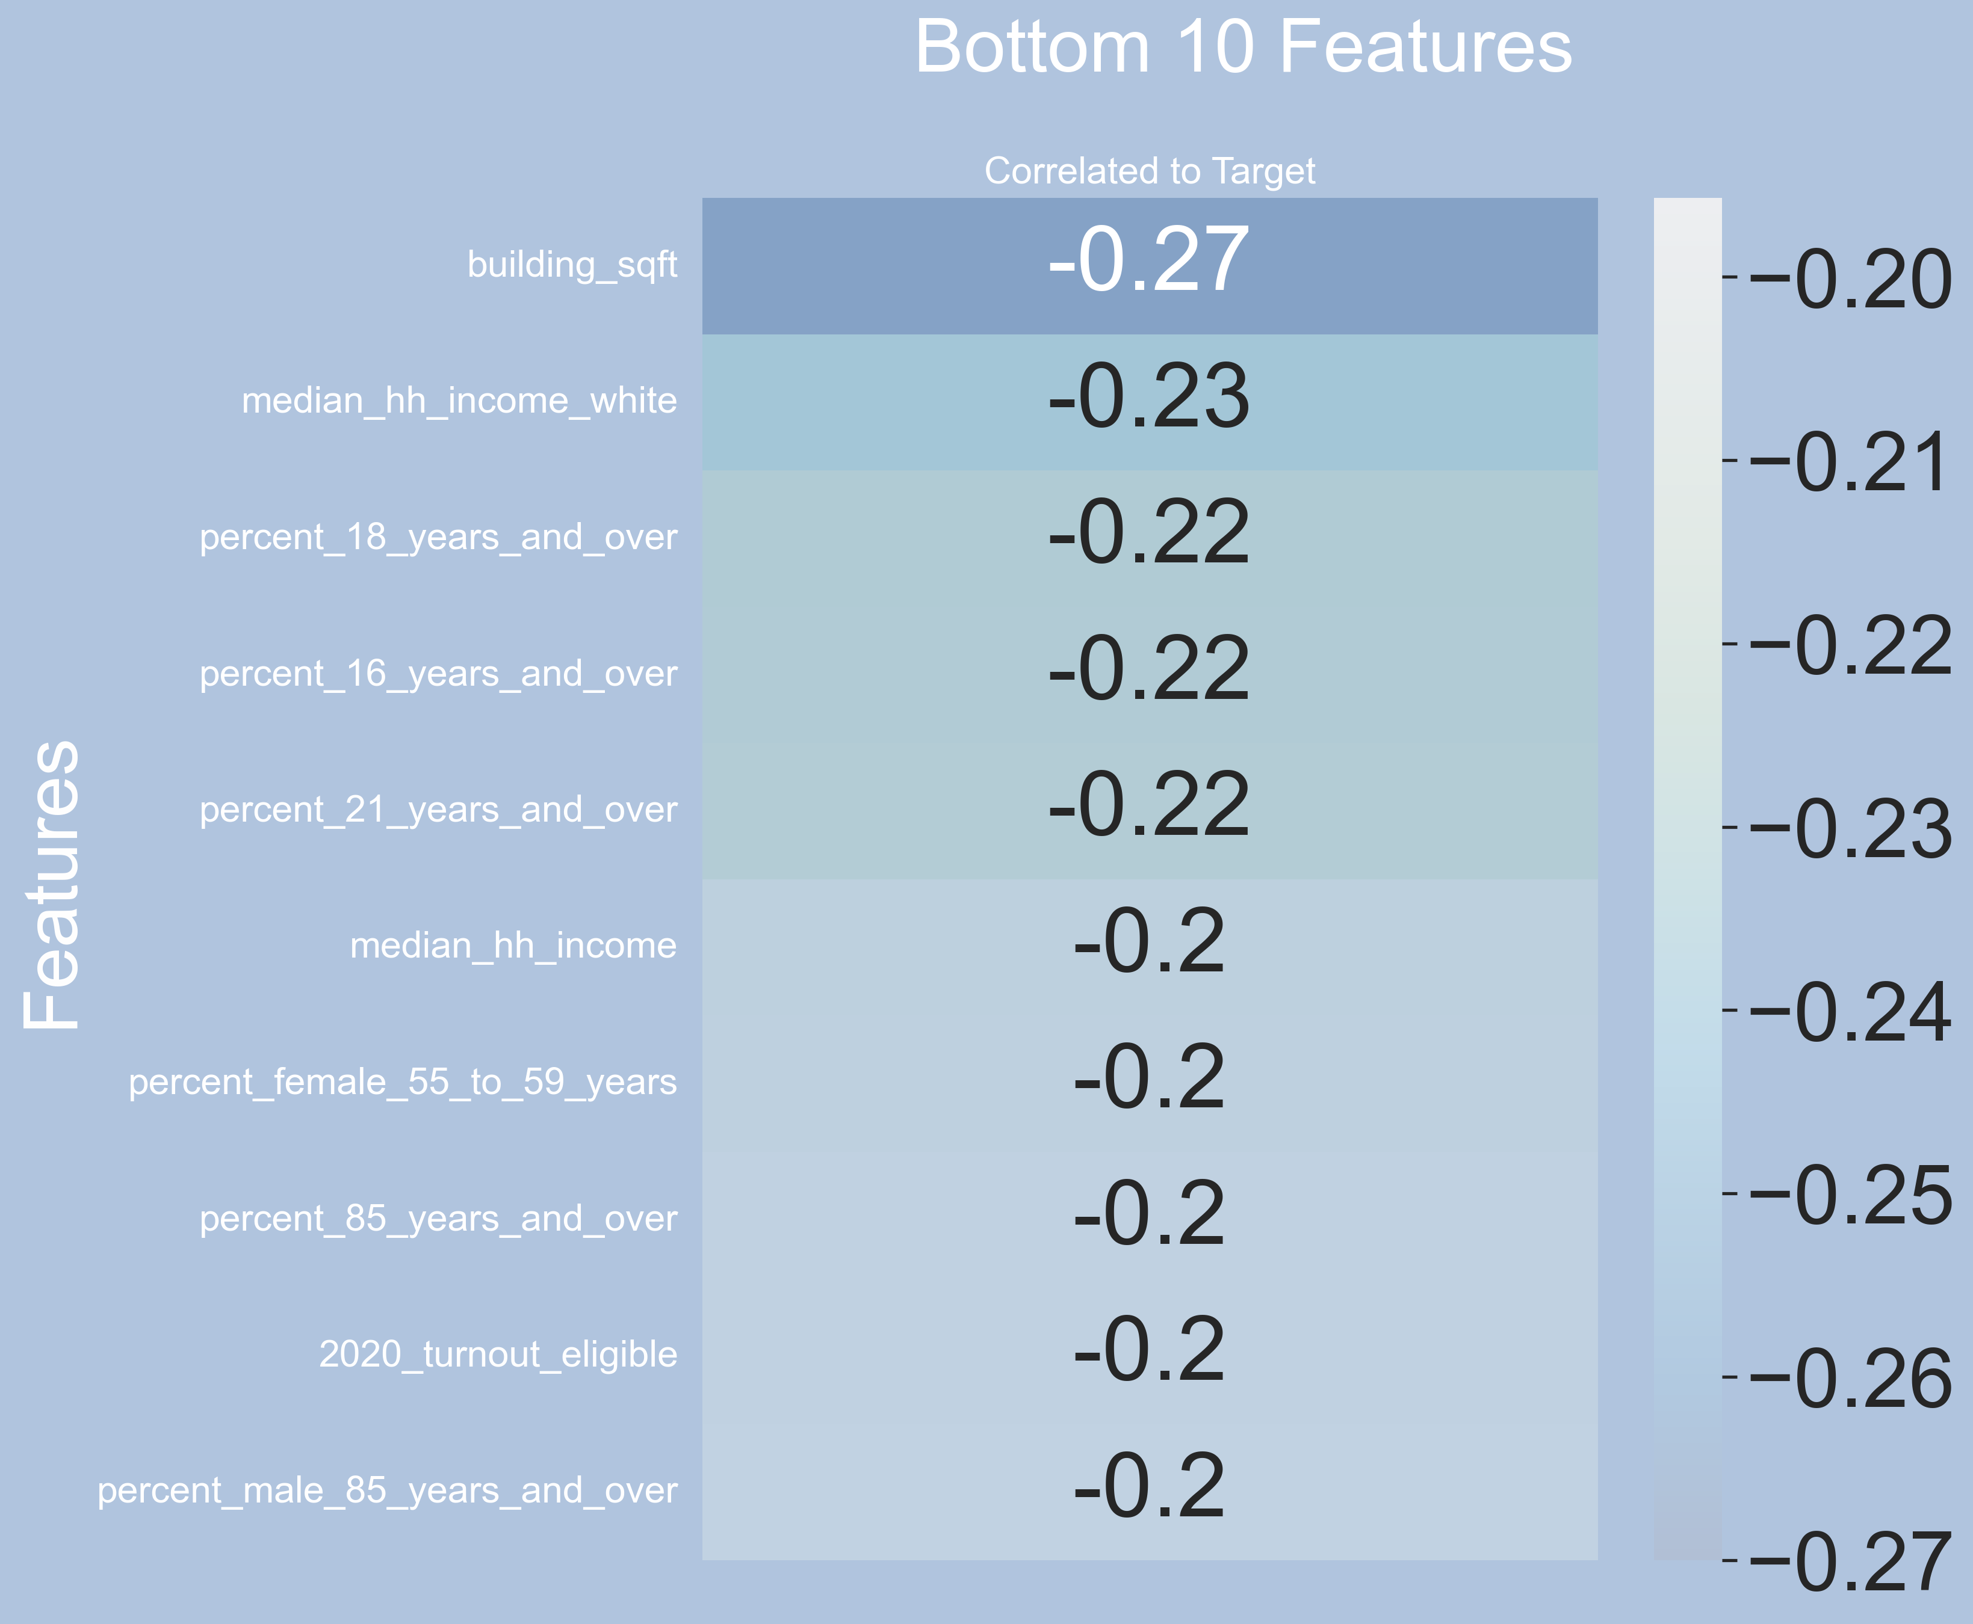
Heat Map
Negative

Slide 39
